Slide 1
Development of a computer vision software for a fire-hazard rescue robot
Rafael Guimaraes de Paula

Slide 2
Introduction
In fire accidents, it is highly risk process for a rescue team to save the lives and even to find and communicate with those who captured in it.
Currently, in order to overcome these problems and to rescue the victims lives, the robotic technology is the most promissory method.
<número>

Slide 3
Objective
This project aims to develop a computer vision software and, through a embedded camera on a autonomous rescue robot, be able to detect human faces and to find victim's on a fire hazard that may be unconscious or not.
<número>

Slide 4
Applications
* Rescue robots will replace rescue staffs and can avoid the risk of them getting harm too in a fire hazard. * This concept can also be used in another kind of hazards, such as toxic leak and against criminal occupation or kidnapping.
<número>

Slide 5
Development Tools
OpenCV
It is an Open Source Computer Vision Library, having more than 2500 optimized algorithms.
Qt Framework
It is a cross-platform framework, mainly used for develop applications with graphical user interfaces.
<número>

Slide 6
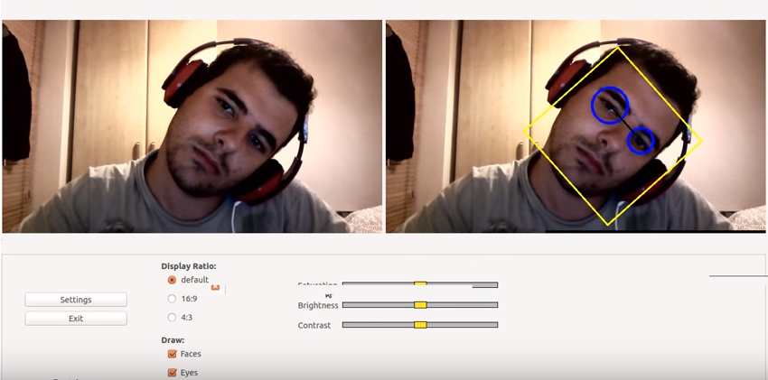
Prototype results
<número>

Slide 7
Thank You!
<número>

